Slide 1
Bespoke library docking for 5-HT2A receptor agonists with antidepressant activity
BITTER DB
Anat Levit Kaplan, Danielle N. Confair, Kuglae Kim, Ximena Barros-Álvarez, Ramona M. Rodriguiz, Ying Yang, Oh Sang Kweon, Tao Che, John D. McCorvy, David N. Kamber, James P. Phelan, Luan Carvalho Martins, Vladimir M. Pogorelov, Jeffrey F. DiBerto, Samuel T. Slocum, Xi-Ping Huang, Jain Manish Kumar, Michael J. Robertson, Ouliana Panova, Alpay B. Seven, Autumn Q. Wetsel, William C. Wetsel, John J. Irwin, Georgios Skiniotis, Brian K. Shoichet, Bryan L. Roth & Jonathan A. Ellman
ZINC DB
Rhodium C-H Activation

Slide 2
Question: Can we use this chemical compound library to discover new therapeutics that minimize psychedelic properties and maximize antidepressant activity?
Identify Chemical Core Structures
Plan synthesis
Computationally Filter Molecules
Test in Animal Trials
Make a Decision
Phase I
Phase II
Phase III
Phase IV
Phase V

Slide 3
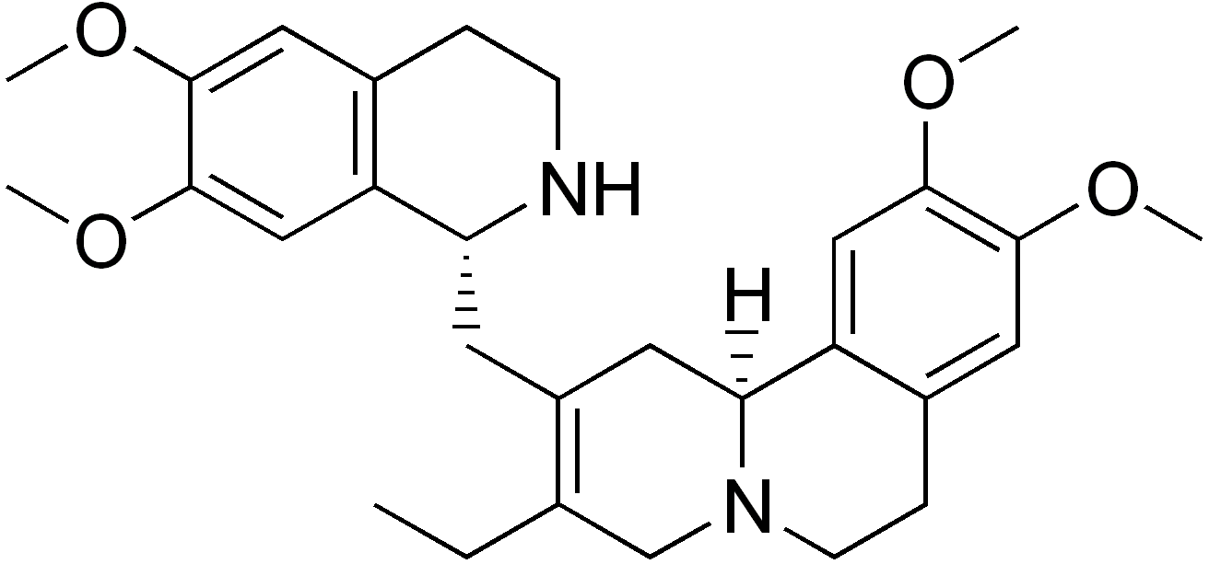
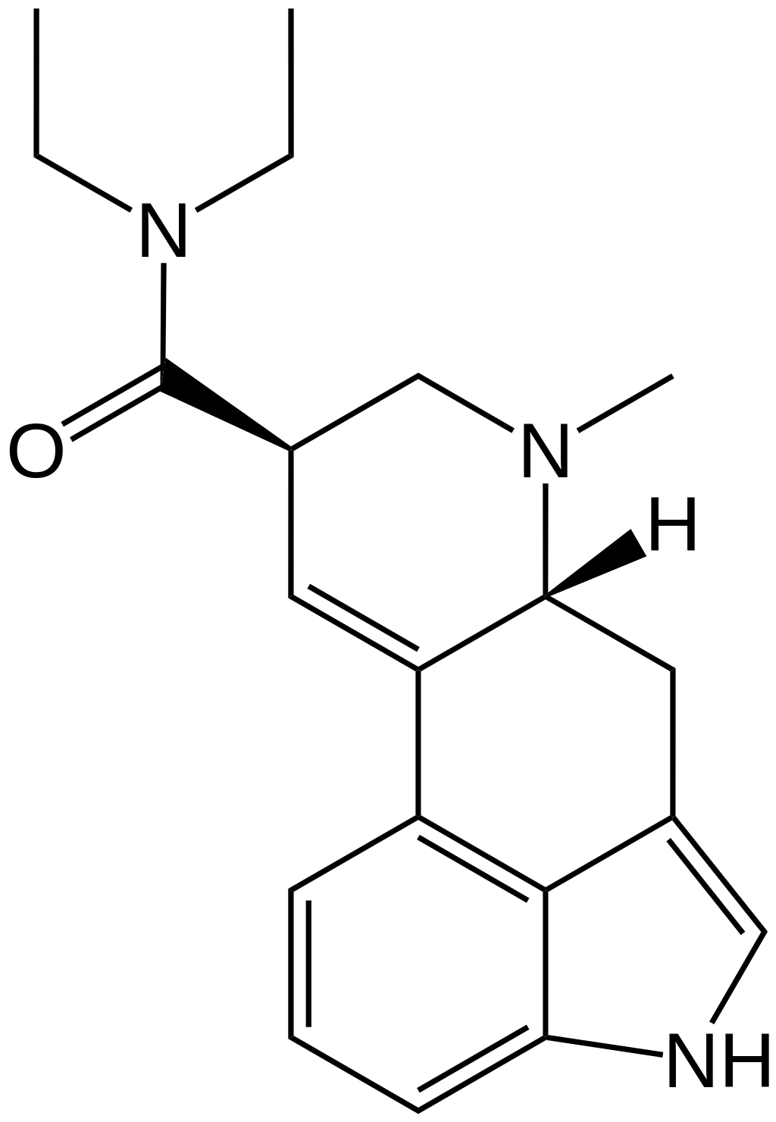
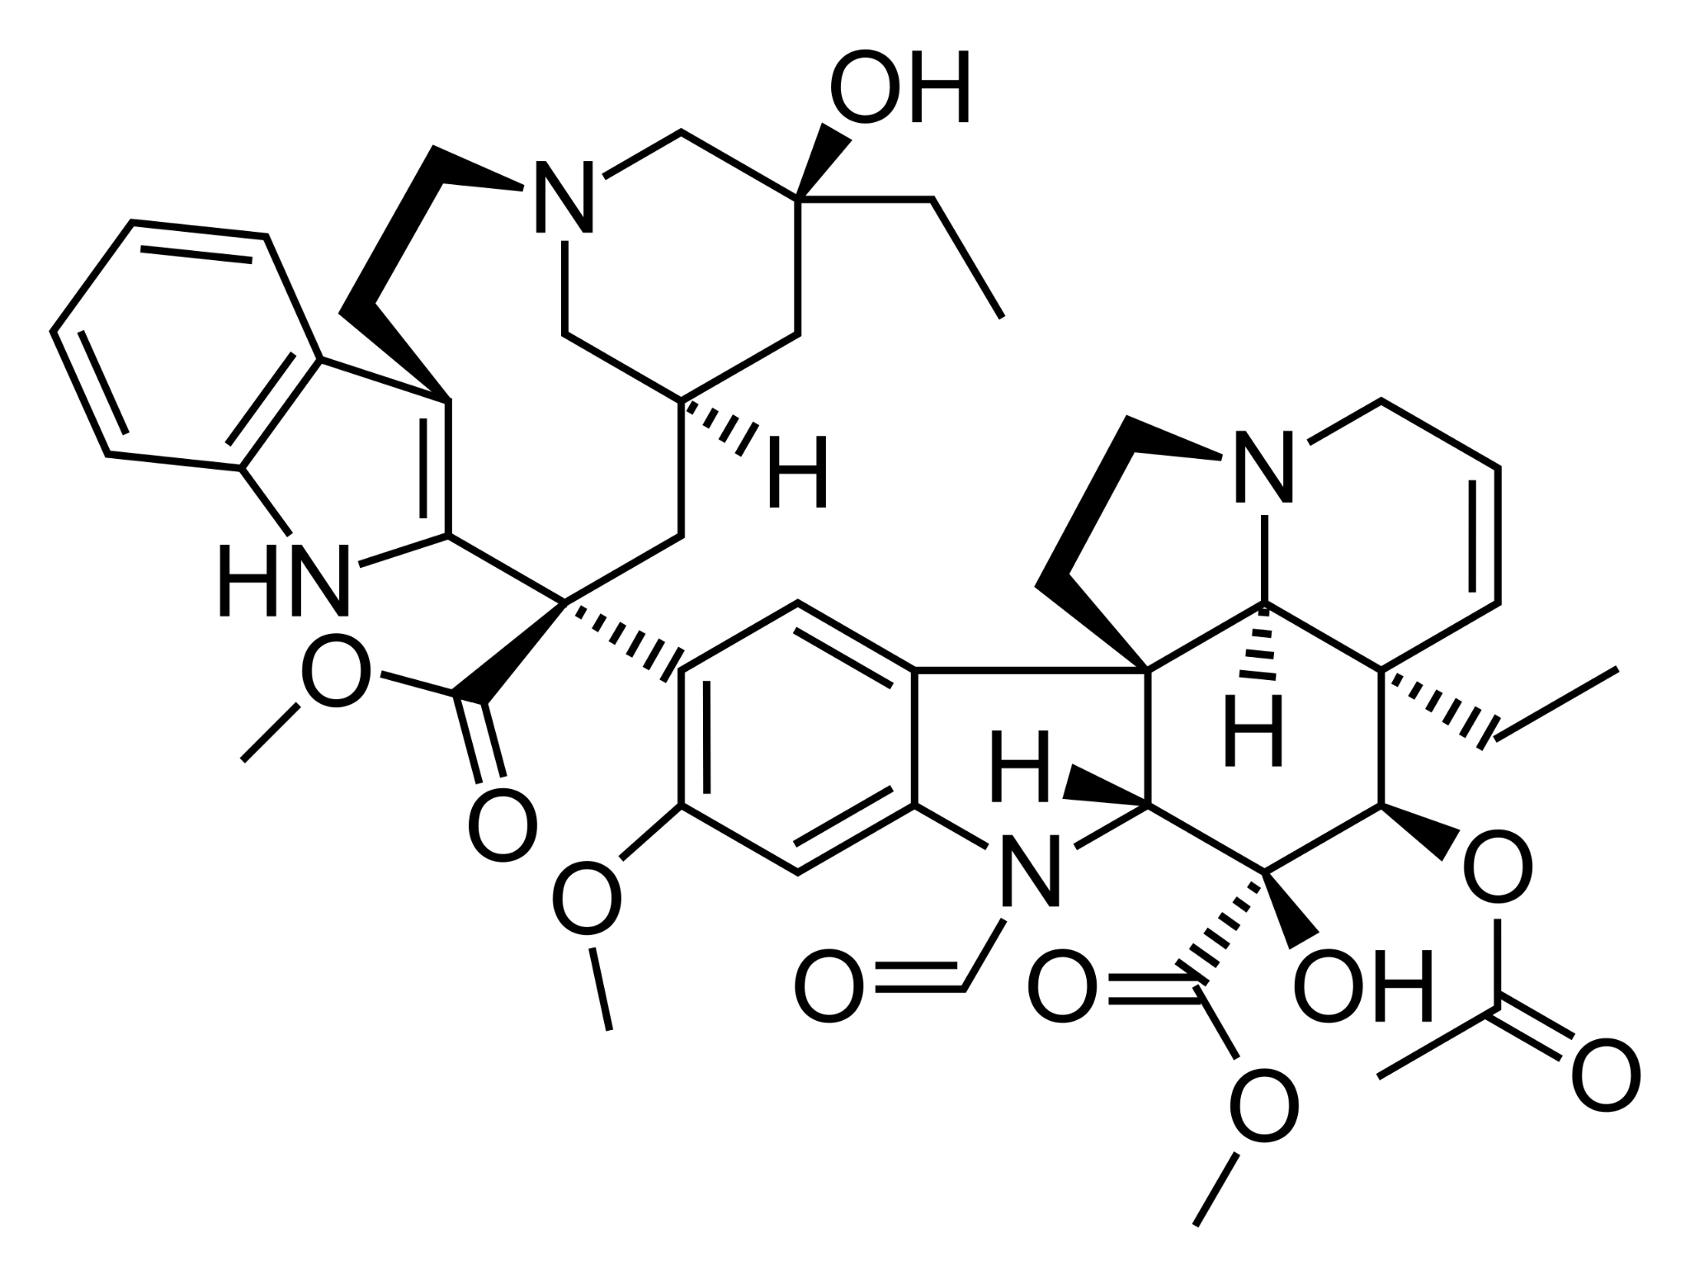
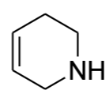
Phase I: Identifying Core Chemical Scaffolds
Dehydroemetine
LSD
Vincristine

Slide 4
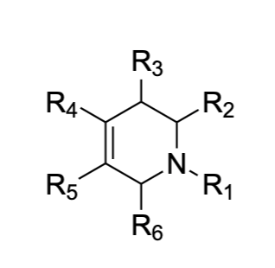
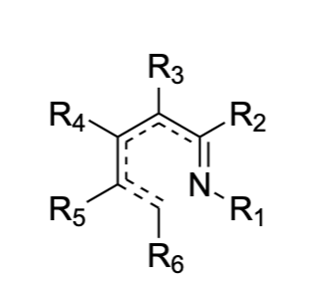
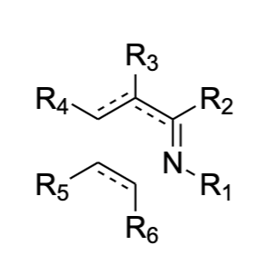
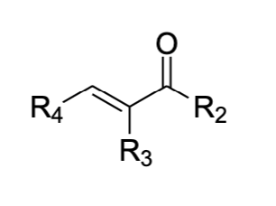
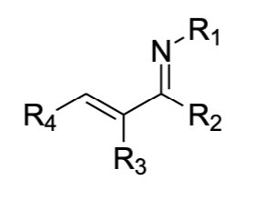
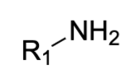
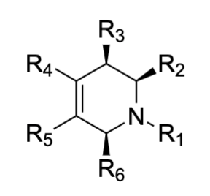
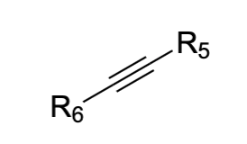
Phase II: Design your synthesis
*
*
*
imine reduction
+
[Rh]
Chemical Space Scaffolds

Slide 5
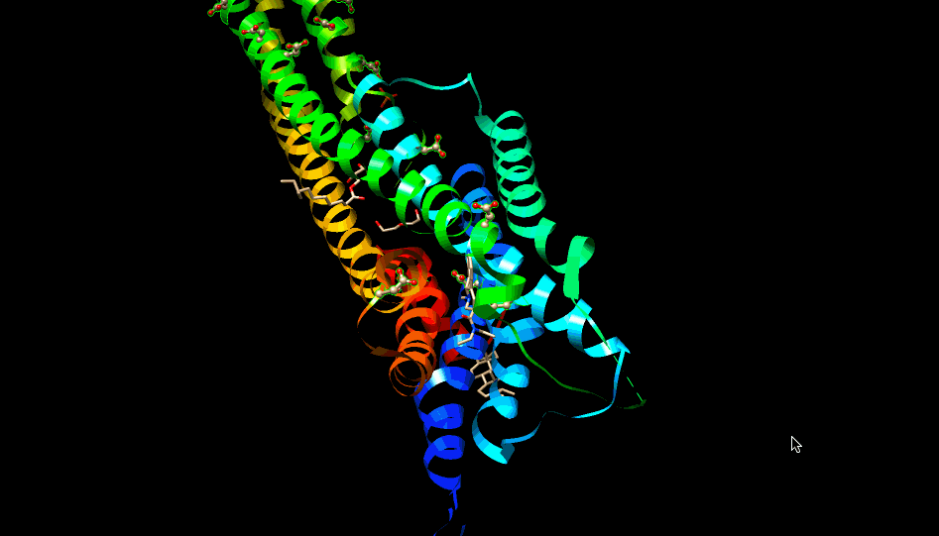

Slide 6
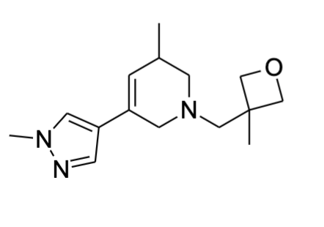
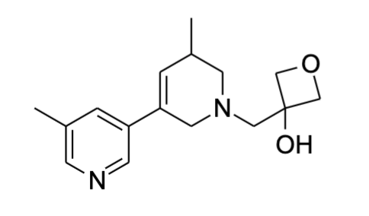
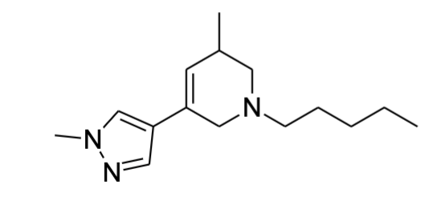
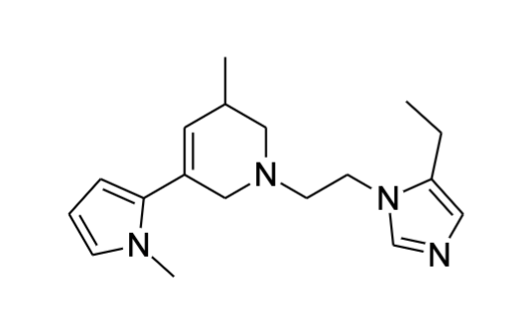
Phase III: Selection of a Molecule
A
Agonist
5-HT_{2A}
Antagonist
B
5-HT_{2B}
5-HT_{2C}
Antagonist
C
D
Agonist / Antagonist

Slide 7
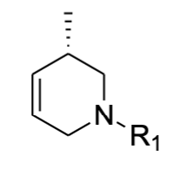
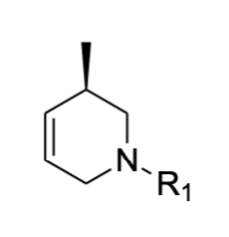
Phase III: Unwritten “Bespoked” Rules
A
Agonist
B
C
Antagonist
D

Slide 8
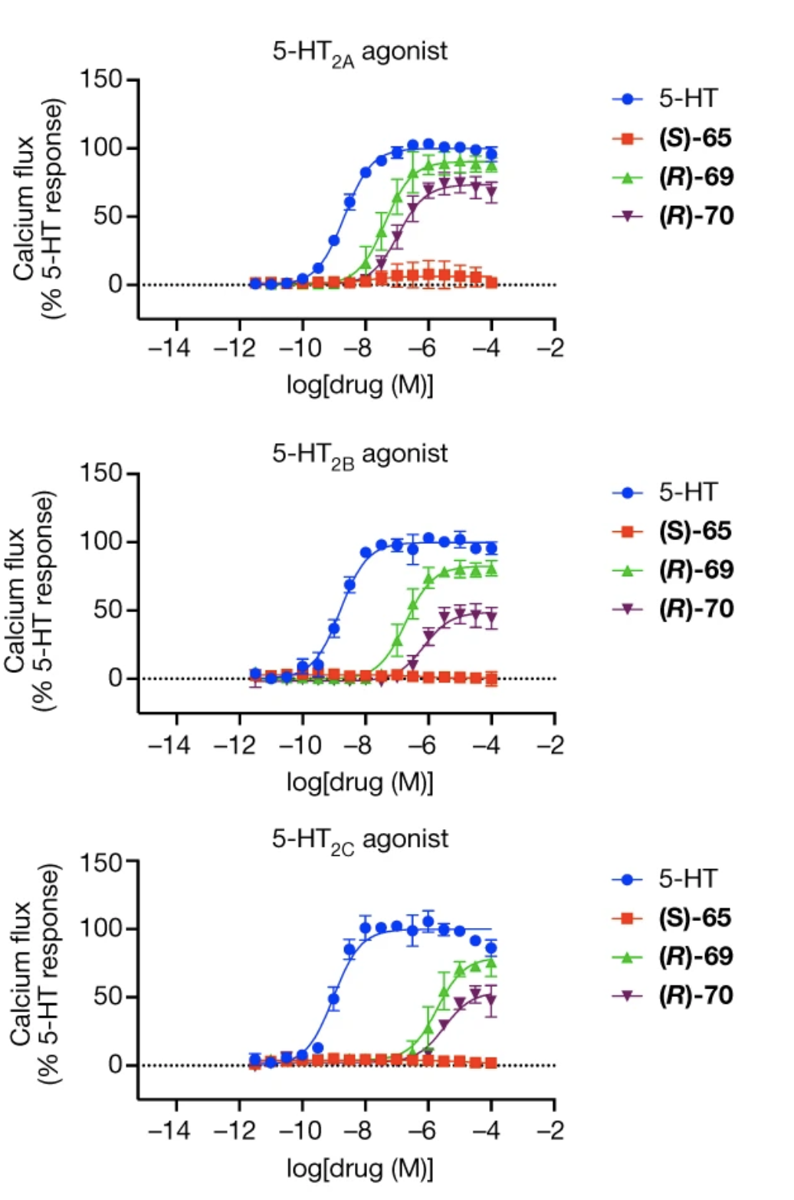
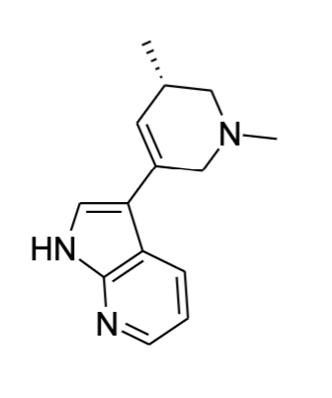
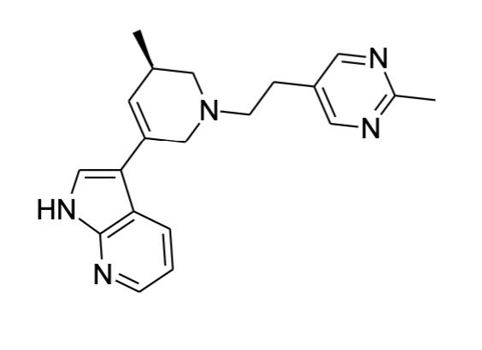
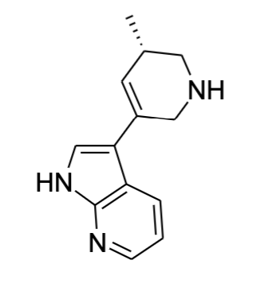
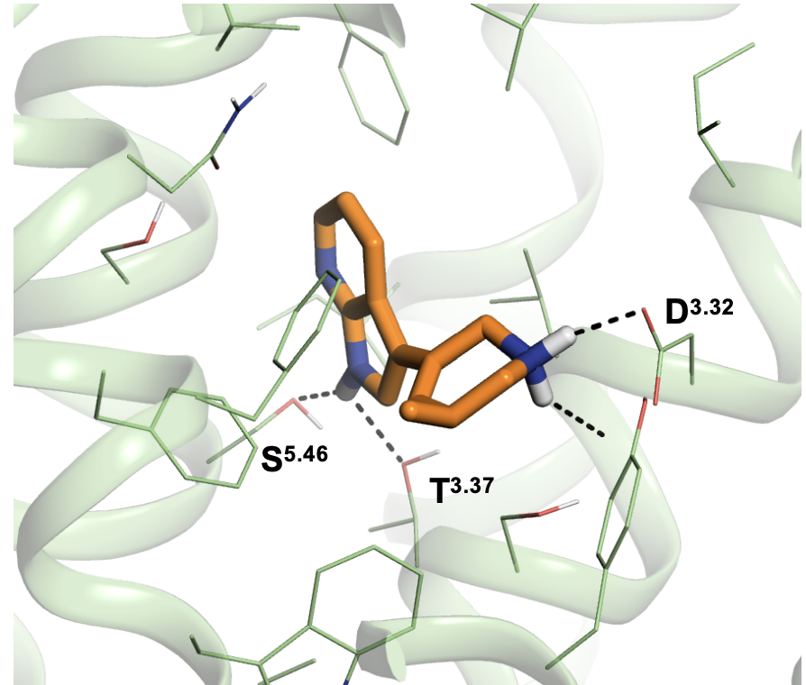
Phase III: Selection of a Molecule
S-65
R-70
R-69

Slide 9
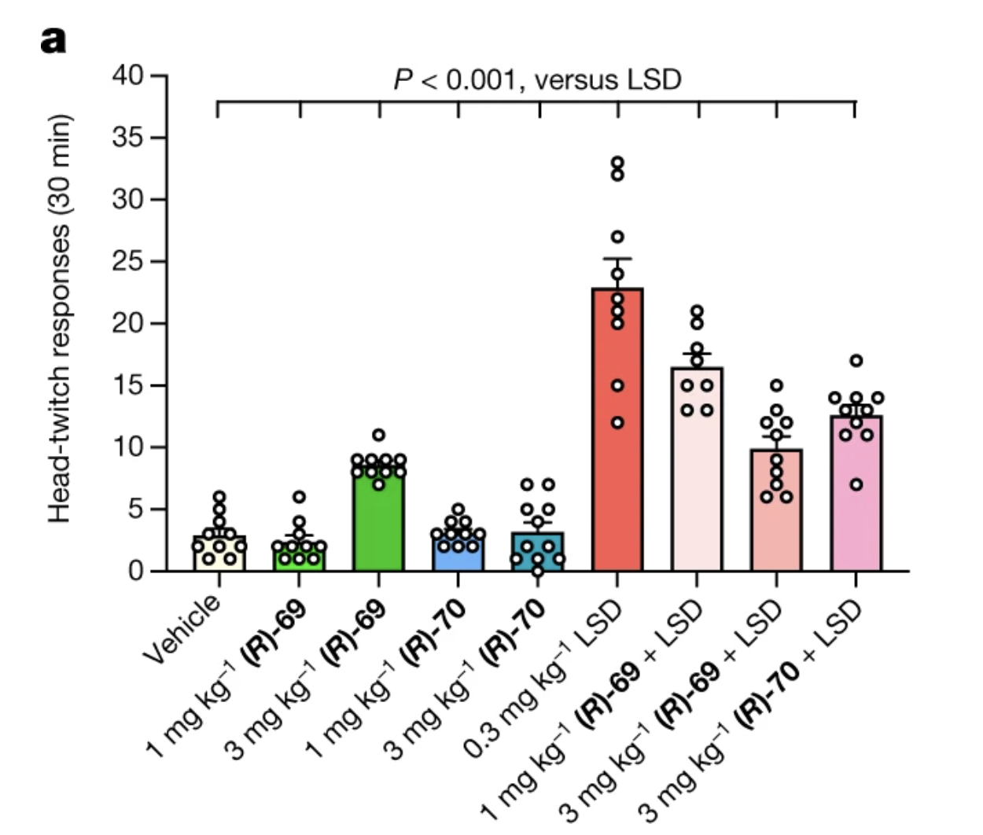
Phase IV: Animal Trial Tests
Possible Antagonist To LSD
Man
Mice
Head Twitching is the same for mice and man in response to hallucinogens - a correlation behaviour from psychopharmacology.

Slide 10
Phase IV: Learned Helplessness
Foot Shock
Induce post traumatic stress disorder
Induce anxiety
Induce depression
Feel helpless over something it has nothing it can control over.
Pain
Getting Better Behaviour Indicators
A preference for sugar water
The tail is suspended longer
Observables

Slide 11
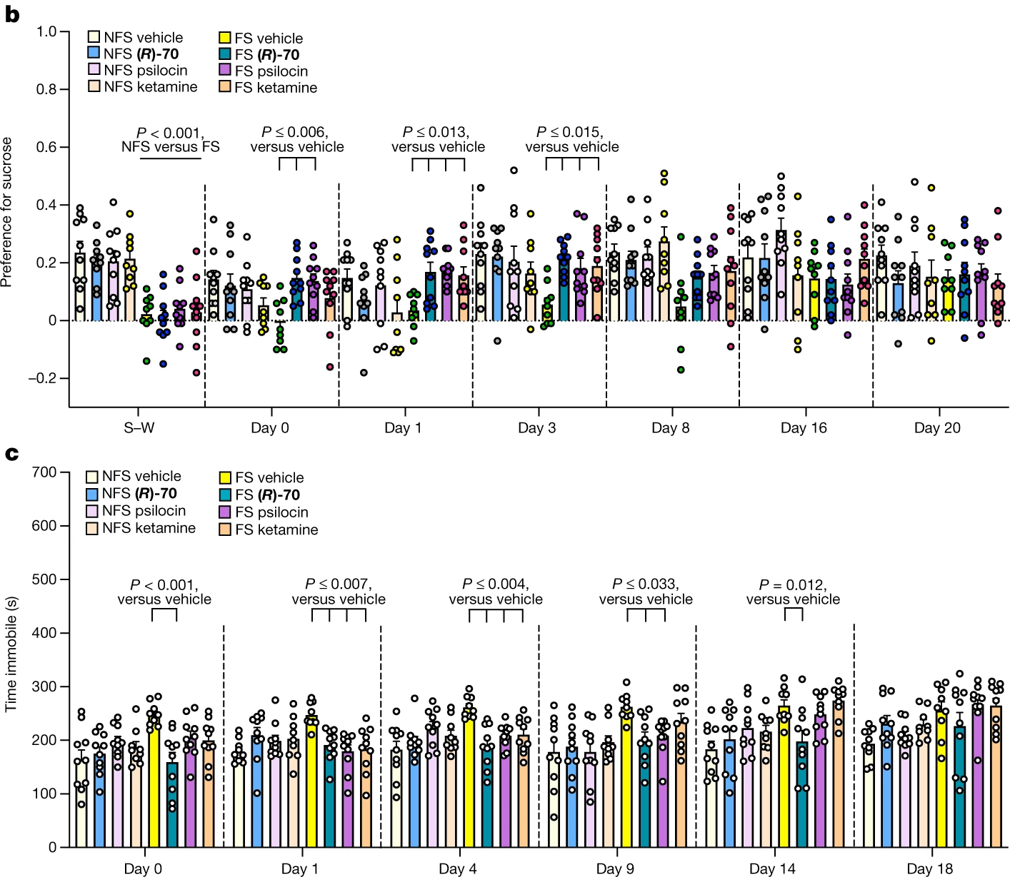
Phase IV: Results
The preference for sucrose seems to go up with increase administration of R-70
Time with tail being immobilized does not seem to be a good indicator of drug action for depression.

Slide 12
Conclusion
How to use this?

